Slide 1

RAVINDER(1619066)
JIND INSTITUE OF ENGINEERING & TECHNOLOGY
MOHIT(1619061)
NETWORK SCANNER -ARP SPOOFER

Slide 2

About
Project
The project allow you to scan all devices in a same local area network and gather MAC Address of the device along with its IP. Also this project allow us to gather all details of the IP address

Slide 3
PROJECT
FRONTEND
Flask is a small and lightweight Python web framework that provides useful tools and features that make creating web applications in Python easier.
Languages & Framework Python
Html css
bootstrap
flask
BACKEND (PYTHON)
Python is an interpreted, interactive, object-oriented programming language. It incorporates modules, exceptions, dynamic typing, very high level dynamic data types, and classes.

Slide 4




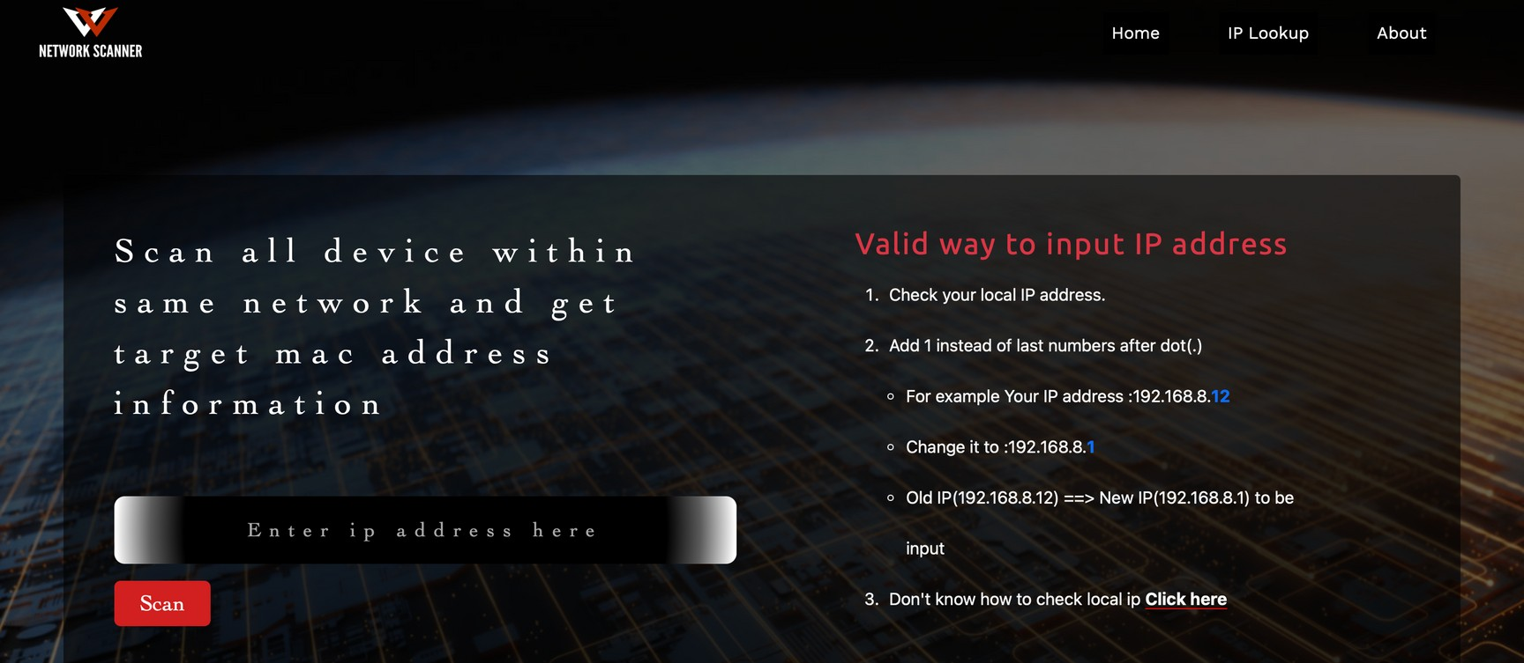
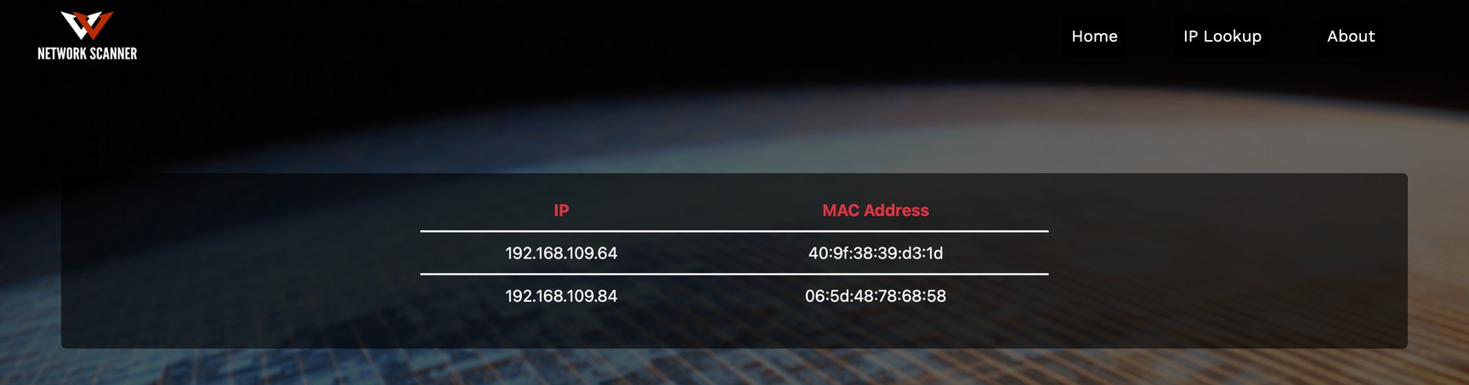
Home Page

Slide 5
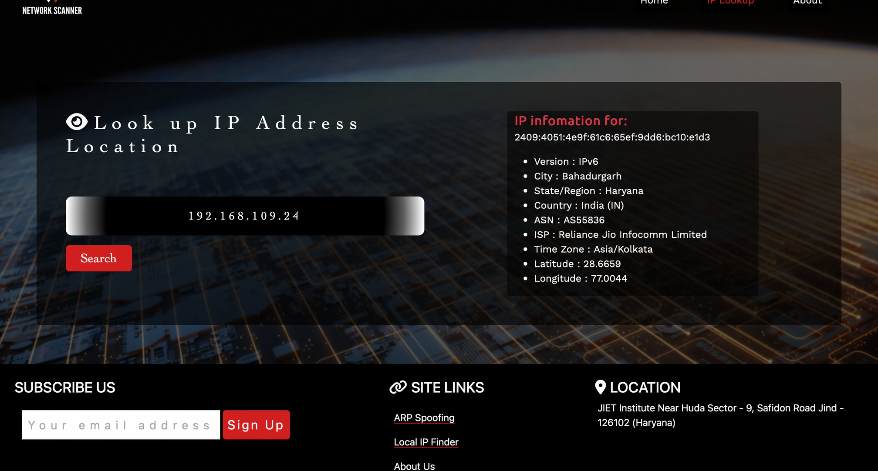
IP-Lookup Page

Slide 6

THANK YOU

